Slide 1
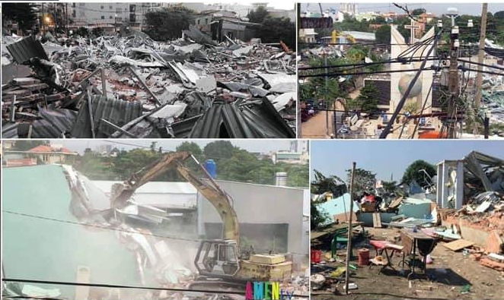
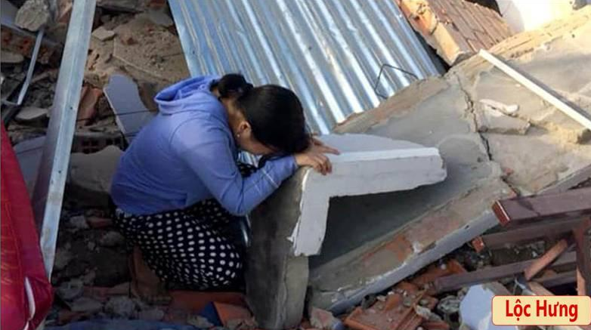
Viet Cong seized the people land by force at LOC HUNG area, 2019.
The VC say people own the land but the state manage them. So the VC can come to seize people lands and houses at any time. Usullay, the VC pay for a chief price, then sell back to the commercial companies for expensive prices, sometimes thousands times more.

