Slide 1
THE CRIMES THAT THE COMMUNISTS (VC) COMMITTED AGAINST THE VIETNAMESE PEOPLE.

Slide 2
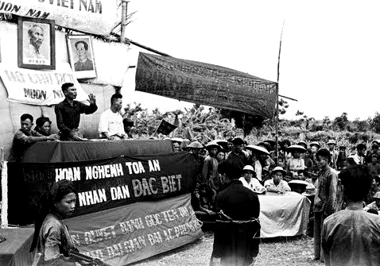
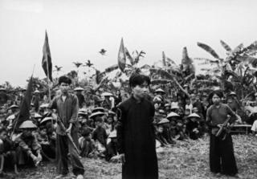
VC’s Mass Murdering during the Land Reforms
1952-1956.
VC killed about 200 thousands innocent North Vietnamese during the Land Reforms.
Most of them were land-owning famers or intellectuals who were considered the enemies of the communism.
After that, Ho Chi Minh confessed that was a big mistake but no action was taken for the victims or their families.

Slide 3
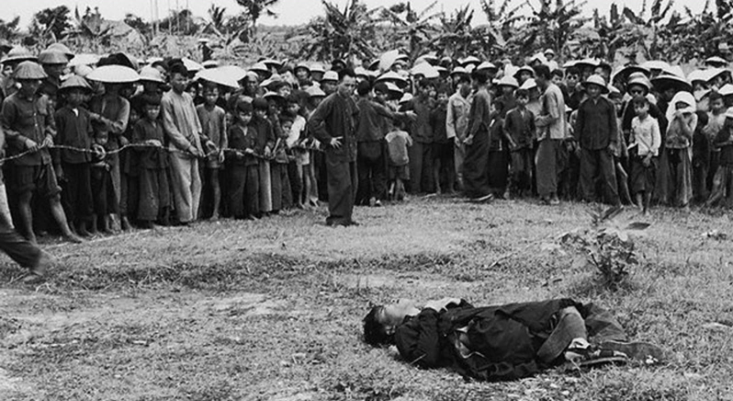
VC’s Mass Murdering during the Land Reforms
1952-1956.
VC killed about 200 thousands innocent North Vietnamese during the Land Reforms.
Most of them were land-owning famers or intellectuals who were considered the enemies of the communism.
After that, Ho Chi Minh confessed that was a big mistake but no action was taken for the victims or their families.

Slide 4
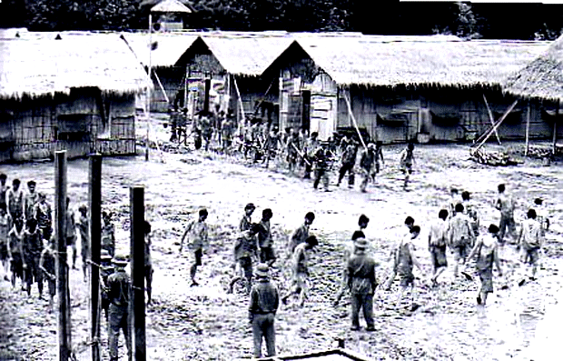
Forced Labor Concentration Camps after 1975
In 1973, VC singed the Paris Peace Agreement that no revenge would be taken.
But after taking over the South Vietnam, they imprisoned about 300 thousands soldiers of the former South Vietnam regime.
Approximate 50 thousands were died in the camps or shortly after released.
- Most were imprisoned from 5 to 15 years.
The prisoners were tortured, abused, force into hard labor while malnourished and lack of medical care.

Slide 5
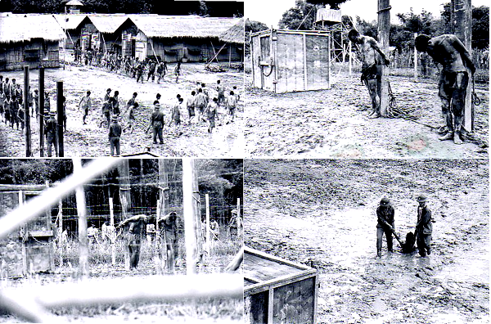
Forced Labor Concentration Camps after 1975
In 1973, VC singed the Paris Peace Agreement that no revenge would be taken.
But after taking over the South Vietnam, they imprisoned about 300 thousands soldiers of the former South Vietnam regime.
Approximate 50 thousands were died in the camps or shortly after released.
- Most were imprisoned from 5 to 15 years.
The prisoners were tortured, abused, force into hard labor while malnourished and lack of medical care.

Slide 6
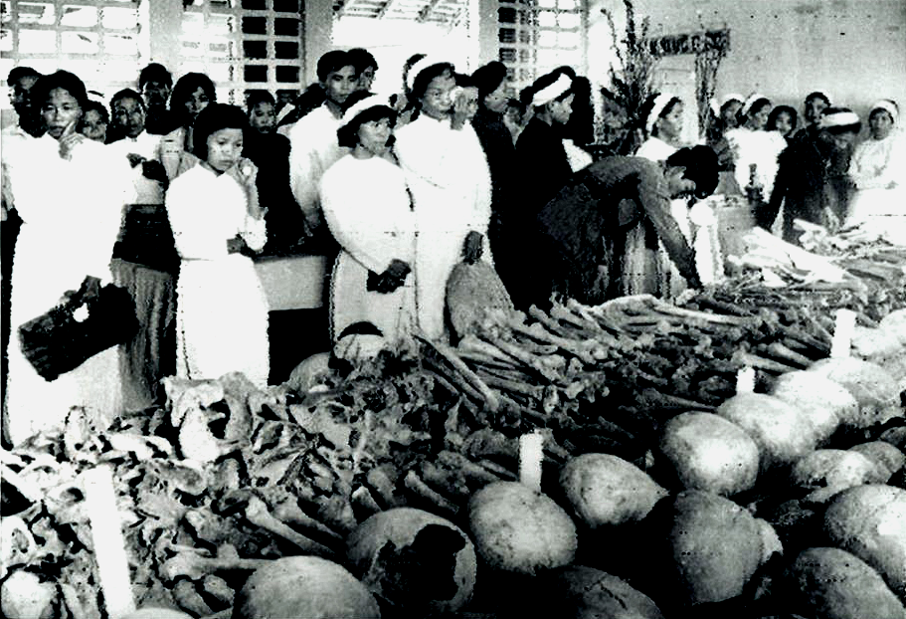
VC’s mass murder in 1968 Tet
In 1968, VC agreed to cease fire during Tet so the Vietnamese can celebrate the New Year.
The VC violated the agreement attacked the South, killed many soldiers and more than 15 thousands of innocent Vietnamese.
The VC have buried more than 5,500 innocent civilians people in HUE province.
The picture shows the remains of innocent people that VC killed in HUE of 1968 Tet.

Slide 7
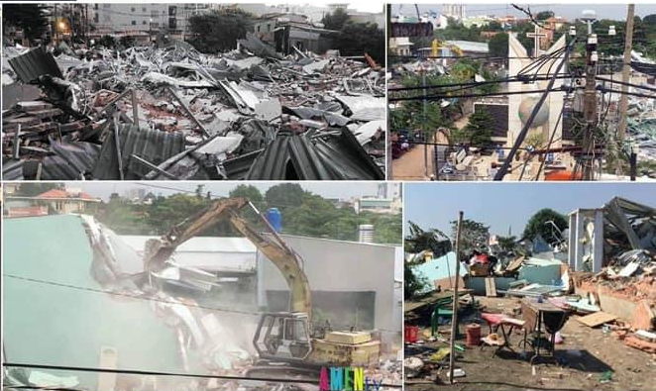
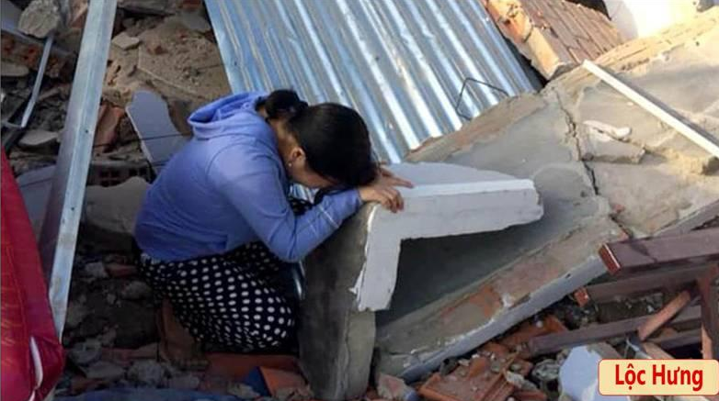
The VC government seized the people’s land by force,
1975-2019.
- They mass evicted with no legal basic the people out of their homes which belong to them for generations. Then the government rezoned the land, sold and devided the profits among their ranking officials.

Slide 8
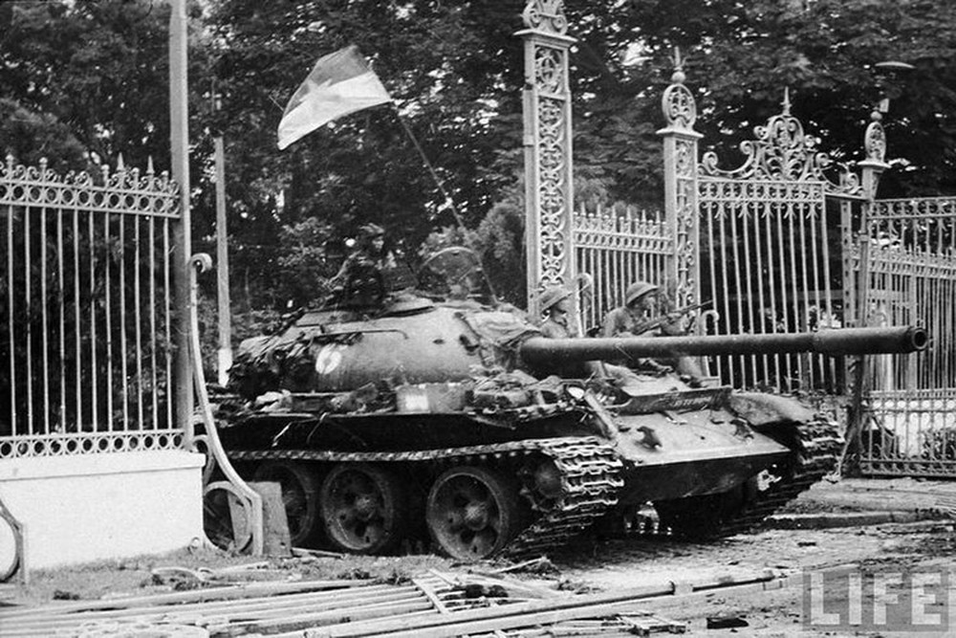
Overthrow the legitimate South VN by force:
Apr 30th, 1975.
The 1973 Paris Agreement specified all forces to withdraw back to their sides and to respect self determination of the Southerners.
But the VC violated and continued to attacked and overthrow the South by force, causing millions fled their homeland.
VC destroyed a budding democracy to set up a totalitarian regime.

Slide 9
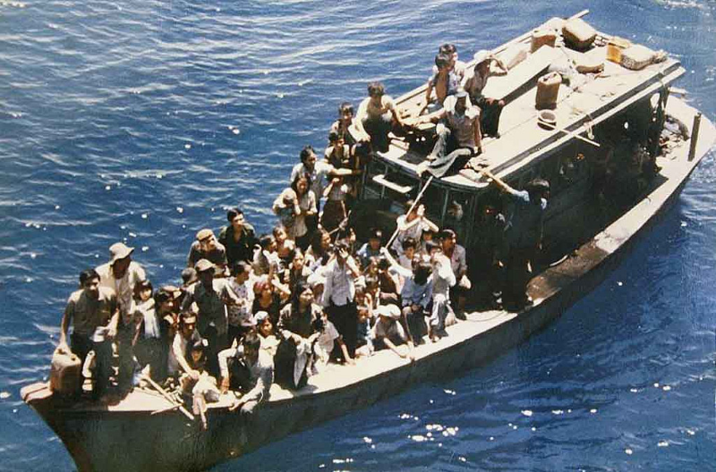
Boat People: Escape from VN by boats.
VC ruled VN with cruelty: rob, abuse, torture, murder, mass muder…
That caused millions Vietnamese escaped from VN, mostly by boats.
About 1 million people made it to free countries.
Estimating 50% boat perished in the sea and jungles.

Slide 10
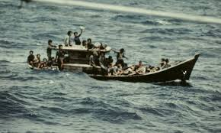
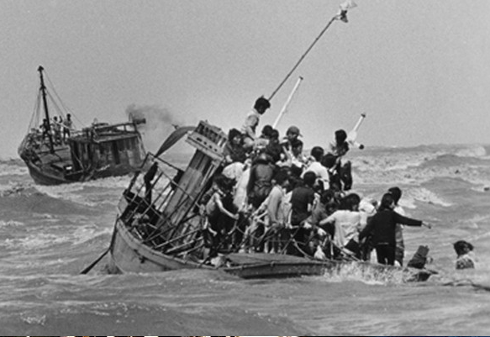
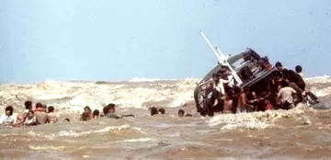
Boat People: Escape from VN by boats.
VC ruled VN with cruelty: rob, abuse, torture, murder, mass muder…
That caused millions Vietnamese escaped from VN, mostly by boats.
About 1 million people made it to free countries.
Estimating 50% boat perished in the sea and jungles.

Slide 11
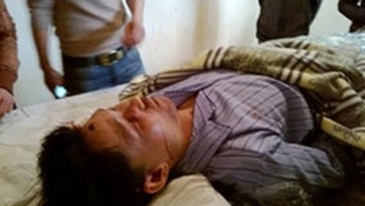
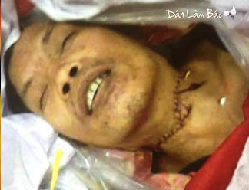
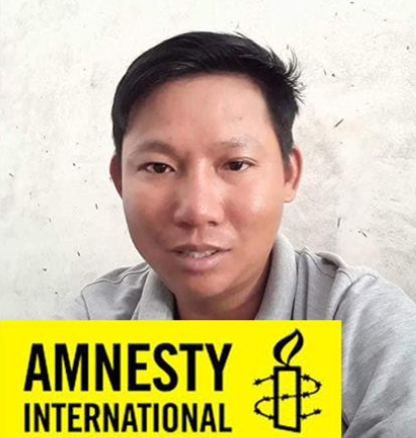
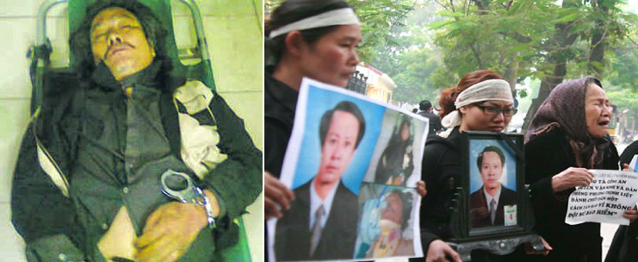
Killing innocent people in Police stations
Every year, a few hundreds innocent Vietnamese were killed in police stations.
The communists blamed the victims for suicide.
The victims families were forced to bring the bodies home and buried them immediately. No further investigations or actions would be allowed.

